Slide 2

Insurance Application
Group P02:
Ankit J. Sharma
Arbaz Khan
Saurabh Kurmi

Slide 3

Content
Introduction
Technology Stack
Diagrams
Best Practices Followed
Demo

Slide 4

Introduction
The “Insurance Application” has been developed for automatically complete the task of insurance clients. It eliminates the manual tasks process and makes communication better between company and its clients. Insurance Application provide various insurance categories and policies to customers and customers can pick any policy according to their need and conditions.
This web application also provides management functionalities to Admin and Under writer.

Slide 5






Technology Stack
Presentation layer: Angular
Business layer: Spring Boot and Rest Services
Data Storage: MySQL
Data Access Layer: Spring JPA.
Bootstrap
Docker, Kubernetes, Jenkins

Slide 6
Dependency/Tools
Spring tool Suite
Spring Security
Spring Boot DevTools
Spring Scheduler
Lombok
Postman

Slide 7
Diagrams
Use-Case Diagram
Activity Diagram
ER Diagram
Deployment Diagram

Slide 8
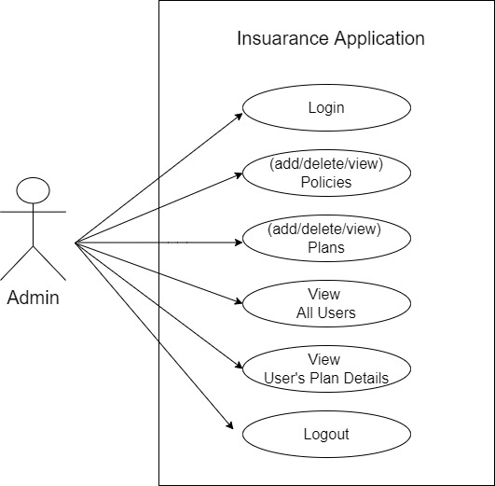
Use Case Diagram : Admin

Slide 9
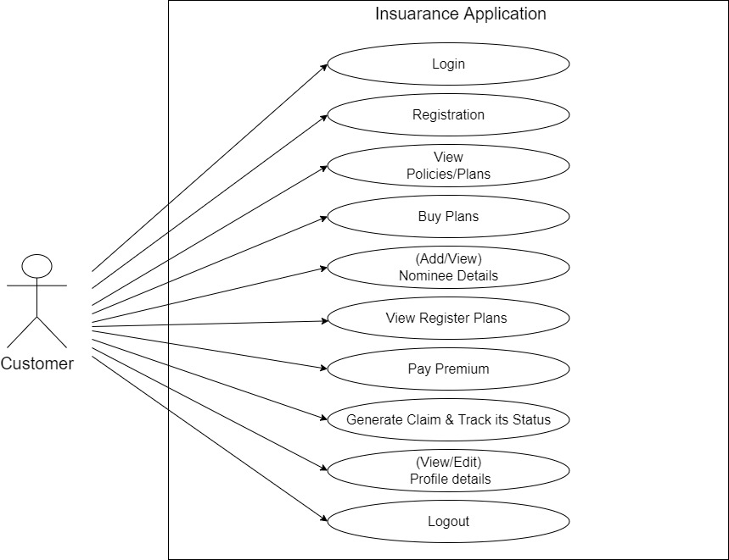
Use Case Diagram :Customer

Slide 10
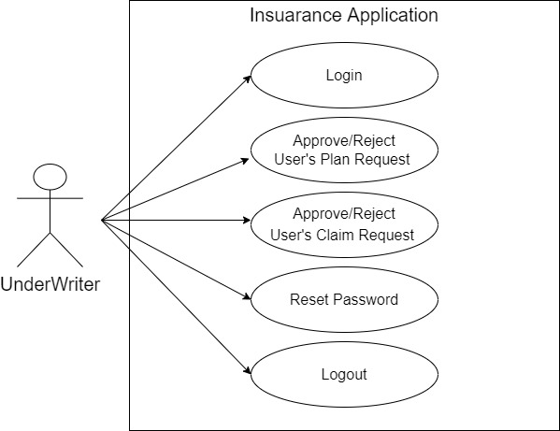
Use Case Diagram : Underwriter

Slide 11
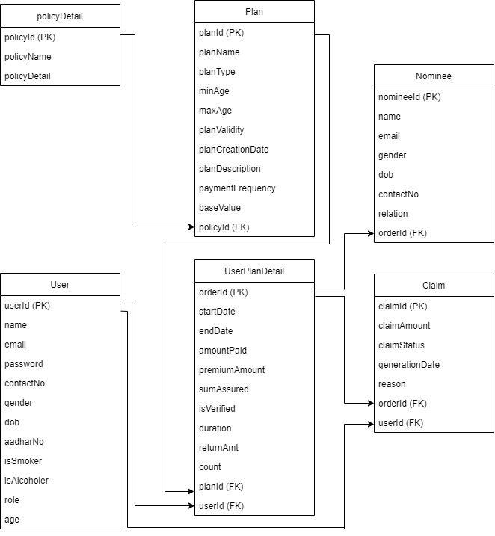
ER Diagram

Slide 12
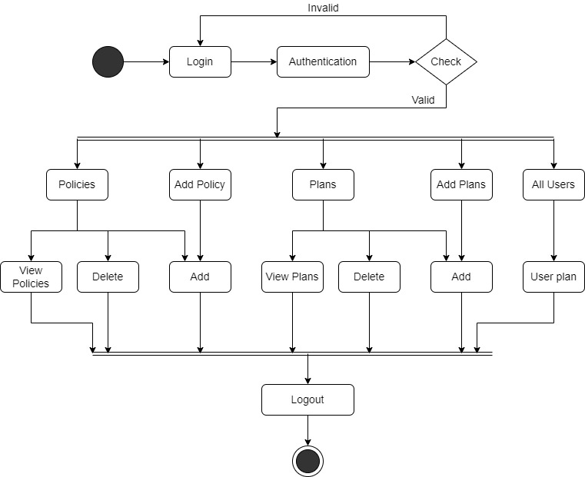
Activity Diagram : Admin

Slide 13
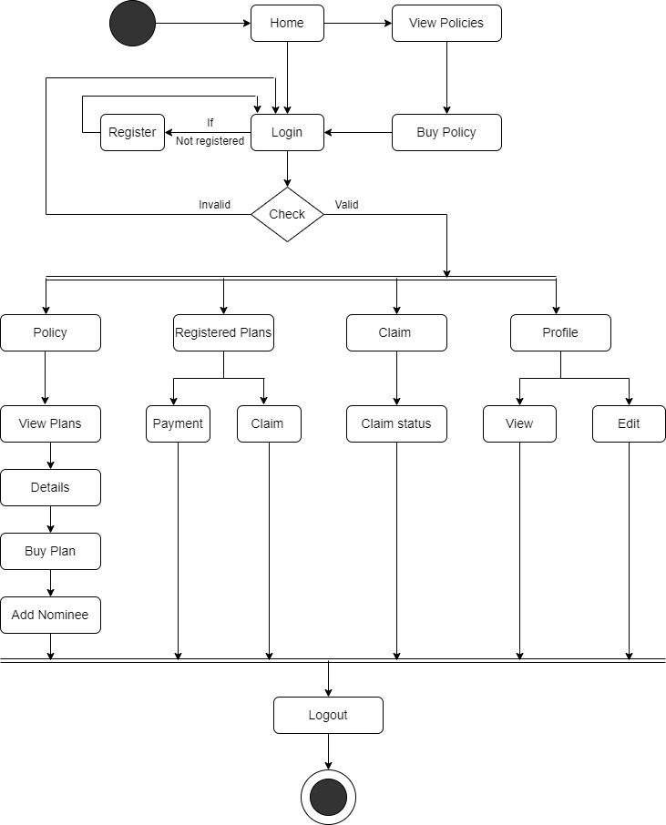
Activity Diagram : Customer

Slide 14
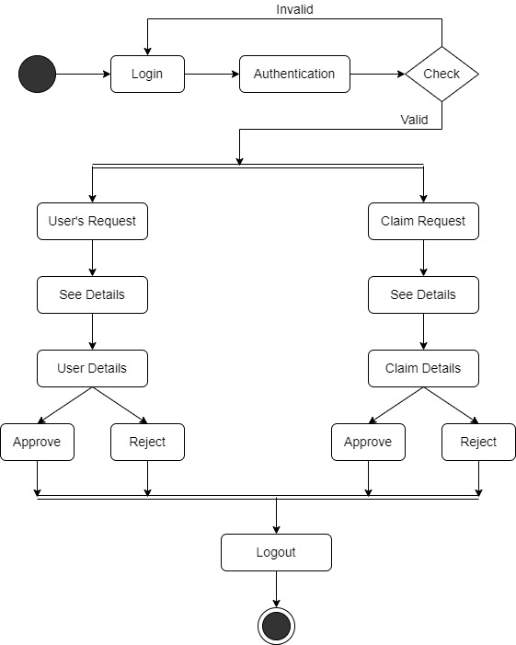
Activity Diagram : Underwriter

Slide 15
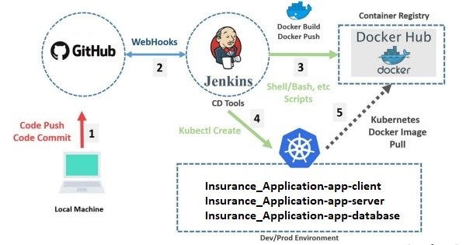
Deployment Diagram

Slide 16

Best Practices Followed:
Java Docs
Naming Conventions
Logging
Exception Handling
Code Quality Checks

Slide 17
Demo

Slide 18
Thank you

